Slide 1
Business Insight 360

Slide 2
Company Profile
AltiQ Hardware is a computer hardware and peripheral manufacture sell their products by various seller both online(E commerce) and offline(Brick and Mortar) mode. Company have their operations in different continents and countries. Now company want to improve their decision-making process by data driven decision.

Slide 3







Customer
Consumer

Slide 4

Platform
Brick and Mortar
E-Commerce

Slide 5
Retailer
Direct
E store
Exclusive
Distributor
Neptune
Local store

Slide 6
Questions before start to build Dashboard
What is the objective of building this PowerBi dashboard?
In what terms the success of this project will be measured?
What will be time dead-line of the project?
do the stakeholders expecting pre-view before the actual release?
What are all the hopes stakeholders have out of this project?
what are all fears the stakeholder have in terms of building this dashboard?
Who are all will be using this dashboard and for what purpose?
what are all expectation the stakeholders have, by the completion of this project?
What can go wrong while building this project?
what are all the resources/ data needed to build this dashboard?
is there any inputs from stakeholders in terms of design and views of the dashboard?

Slide 7
Step 1 Importing data into PowerBi
As the database is MySQL in this project, we need to import the datasets from Mysql database to PowerBi by providing the Database access credential

Slide 8
Step 2 Data Modelling
Data modeling plays a vital role and is considered as the basement of report. All the visuals will be build upon the data model.
Poor data modeling affects the over all performance of the report.
Following Good practices of data modeling is must. Refer this page to get to know the good practices Blog
In this project, we have followed Snowfall data modeling method.

Slide 9
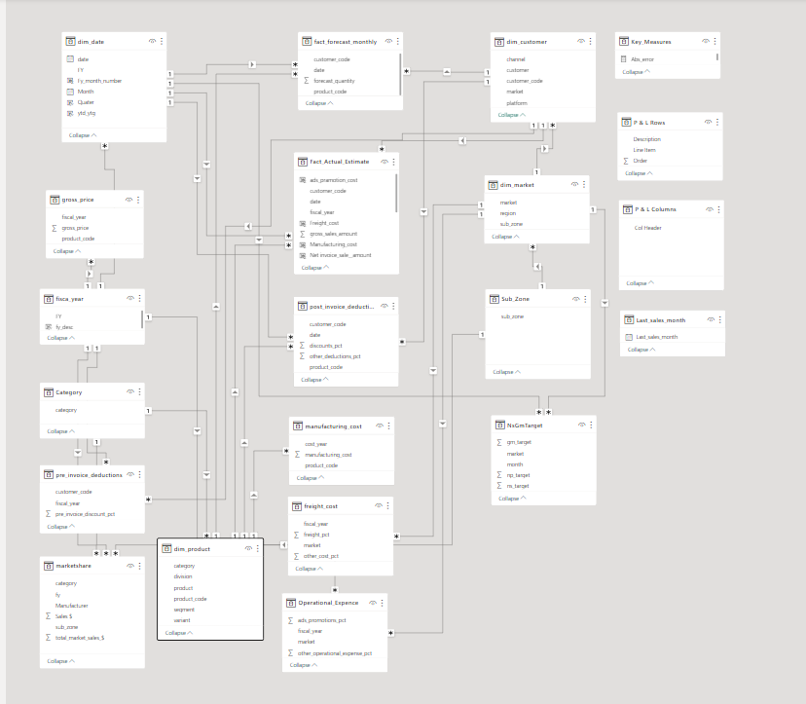

Slide 10
Key Insights
Finance view
Get P & L statement for any customer / product / country or aggregation of the above over any time period and More..
Sales view
Analyze the performance of your customer(s) over key metrics like Net Sales, Gross Margin and view the same in profitability / Growth matrix.
Marketing view
Analyze the performance of your product(s) over key metrics like Net Sales, Gross Margin and view the same in profitability / Growth matrix.
Supply chain view
Get Forecast Accuracy, Net Error and risk profile for product, segment, category, customer etc.
Executive view
A top level dashboard for executives consolidating top insights from all dimensions of business.

Slide 11
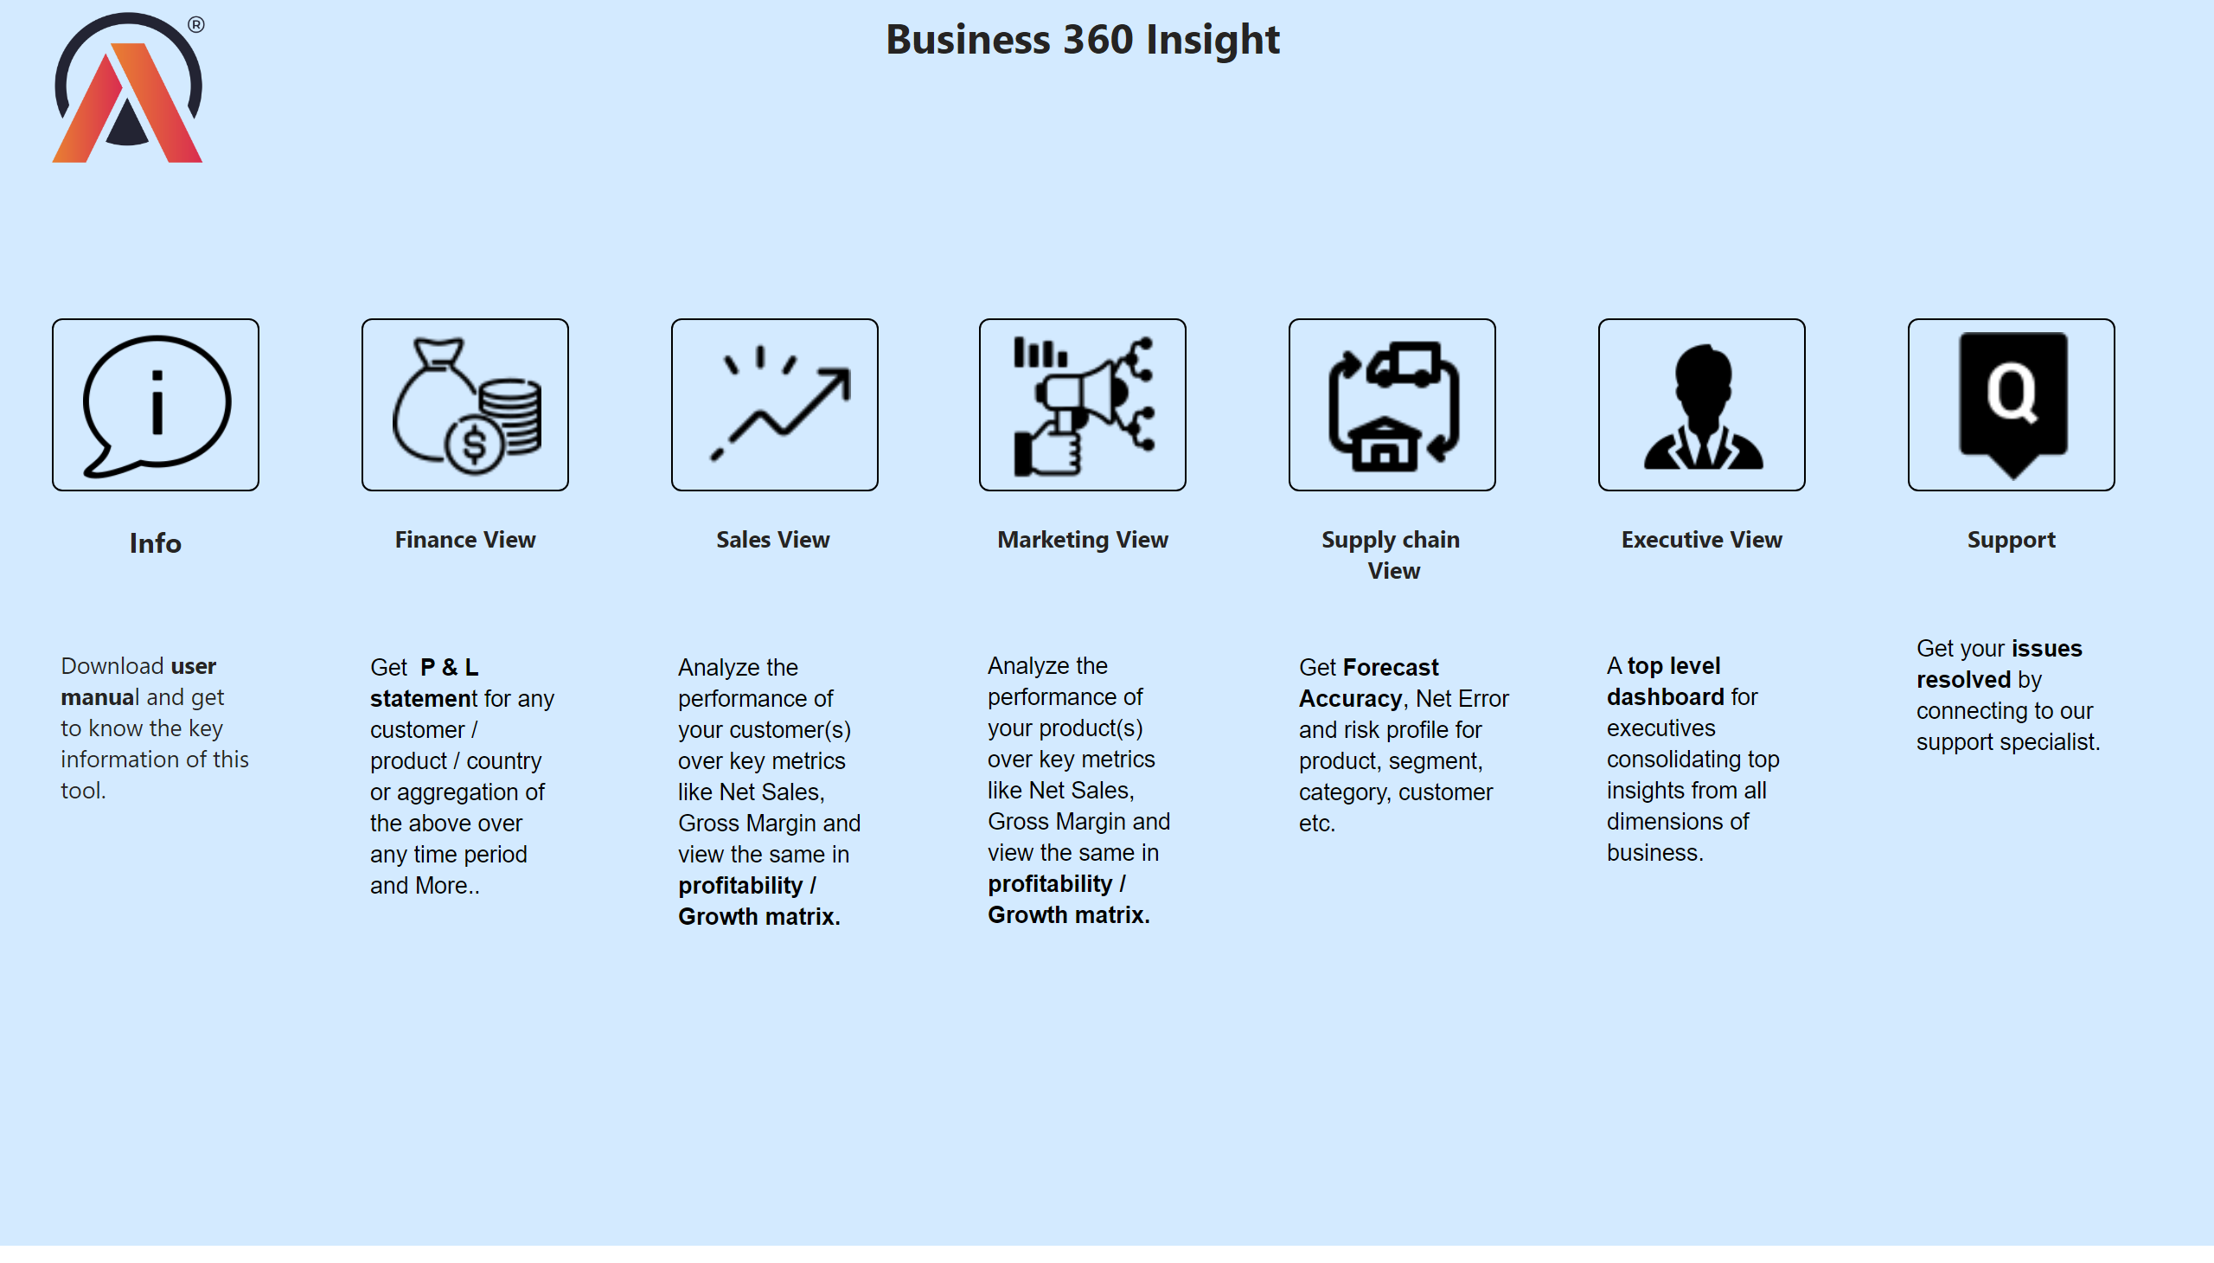
Home
Notes:
image
No alt text provided
image
No alt text provided
image
No alt text provided
image
No alt text provided
image
No alt text provided
image
No alt text provided
image
No alt text provided
textbox
No alt text provided
textbox
No alt text provided
textbox
No alt text provided
textbox
No alt text provided
textbox
No alt text provided
textbox
No alt text provided
textbox
No alt text provided
image
No alt text provided
textbox
No alt text provided
textbox
No alt text provided
textbox
No alt text provided
textbox
No alt text provided
textbox
No alt text provided
textbox
No alt text provided
textbox
No alt text provided
textbox
No alt text provided

Slide 12
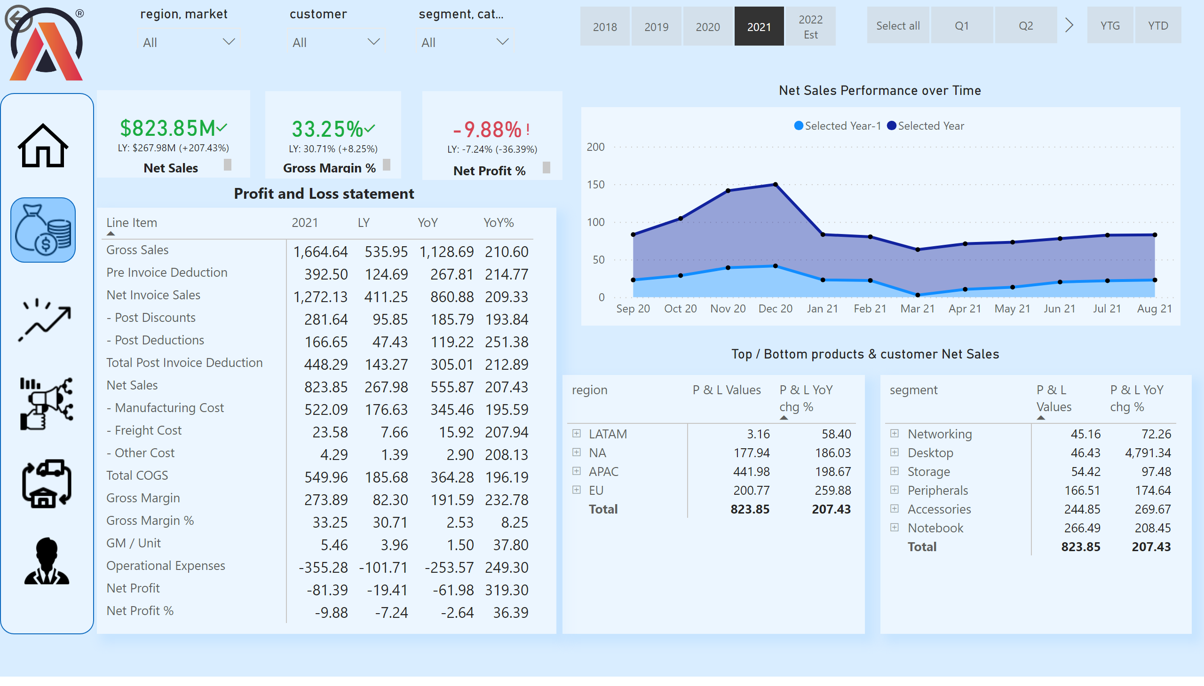
Finance view
Notes:
pivotTable
No alt text provided
actionButton
No alt text provided
slicer
No alt text provided
slicer
No alt text provided
slicer
No alt text provided
Net Sales Performance over Time
No alt text provided
pivotTable
No alt text provided
pivotTable
No alt text provided
card
No alt text provided
card
No alt text provided
textbox
No alt text provided
slicer
No alt text provided
slicer
No alt text provided
slicer
No alt text provided
kpi
No alt text provided
textbox
No alt text provided
kpi
No alt text provided
textbox
No alt text provided
kpi
No alt text provided
image
No alt text provided
textbox
No alt text provided
shape
No alt text provided
image
No alt text provided
image
No alt text provided
image
No alt text provided
image
No alt text provided
image
No alt text provided
image
No alt text provided
shape
No alt text provided

Slide 13
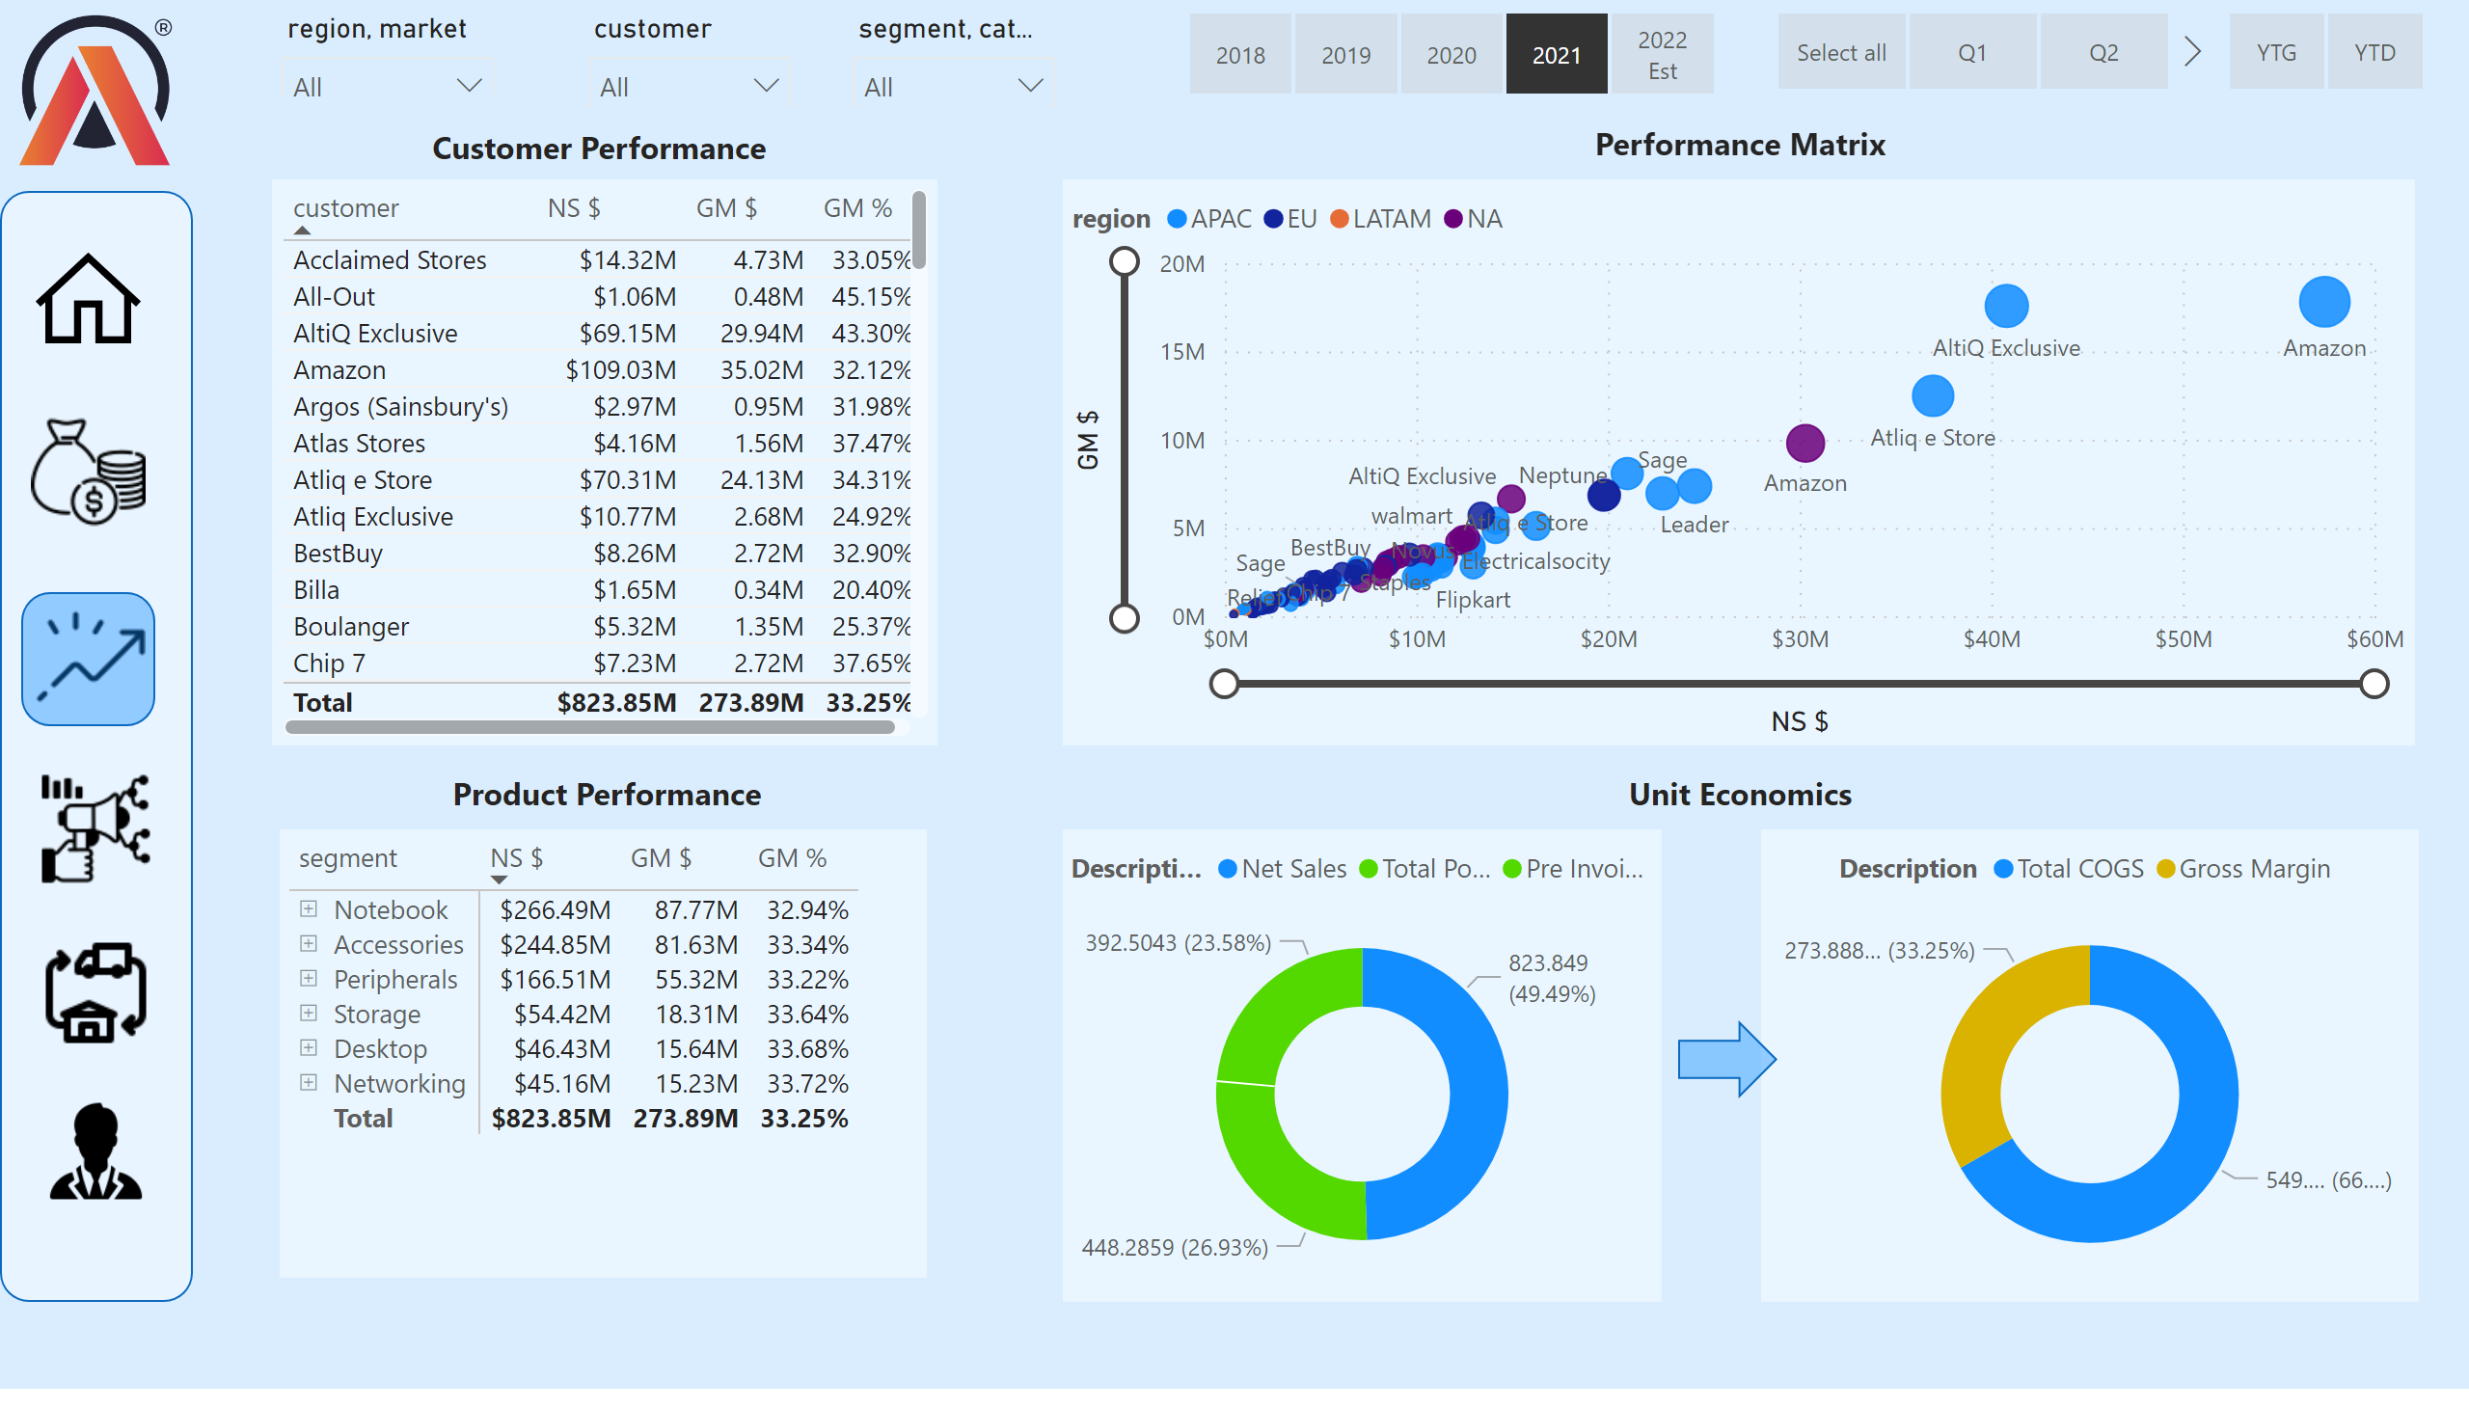
Sales_view
Notes:
tableEx
No alt text provided
scatterChart
No alt text provided
pivotTable
No alt text provided
donutChart
No alt text provided
donutChart
No alt text provided
shape
No alt text provided
image
No alt text provided
image
No alt text provided
image
No alt text provided
image
No alt text provided
image
No alt text provided
image
No alt text provided
shape
No alt text provided
image
No alt text provided
slicer
No alt text provided
slicer
No alt text provided
slicer
No alt text provided
slicer
No alt text provided
slicer
No alt text provided
slicer
No alt text provided
shape
No alt text provided
textbox
No alt text provided
textbox
No alt text provided
textbox
No alt text provided
textbox
No alt text provided

Slide 14
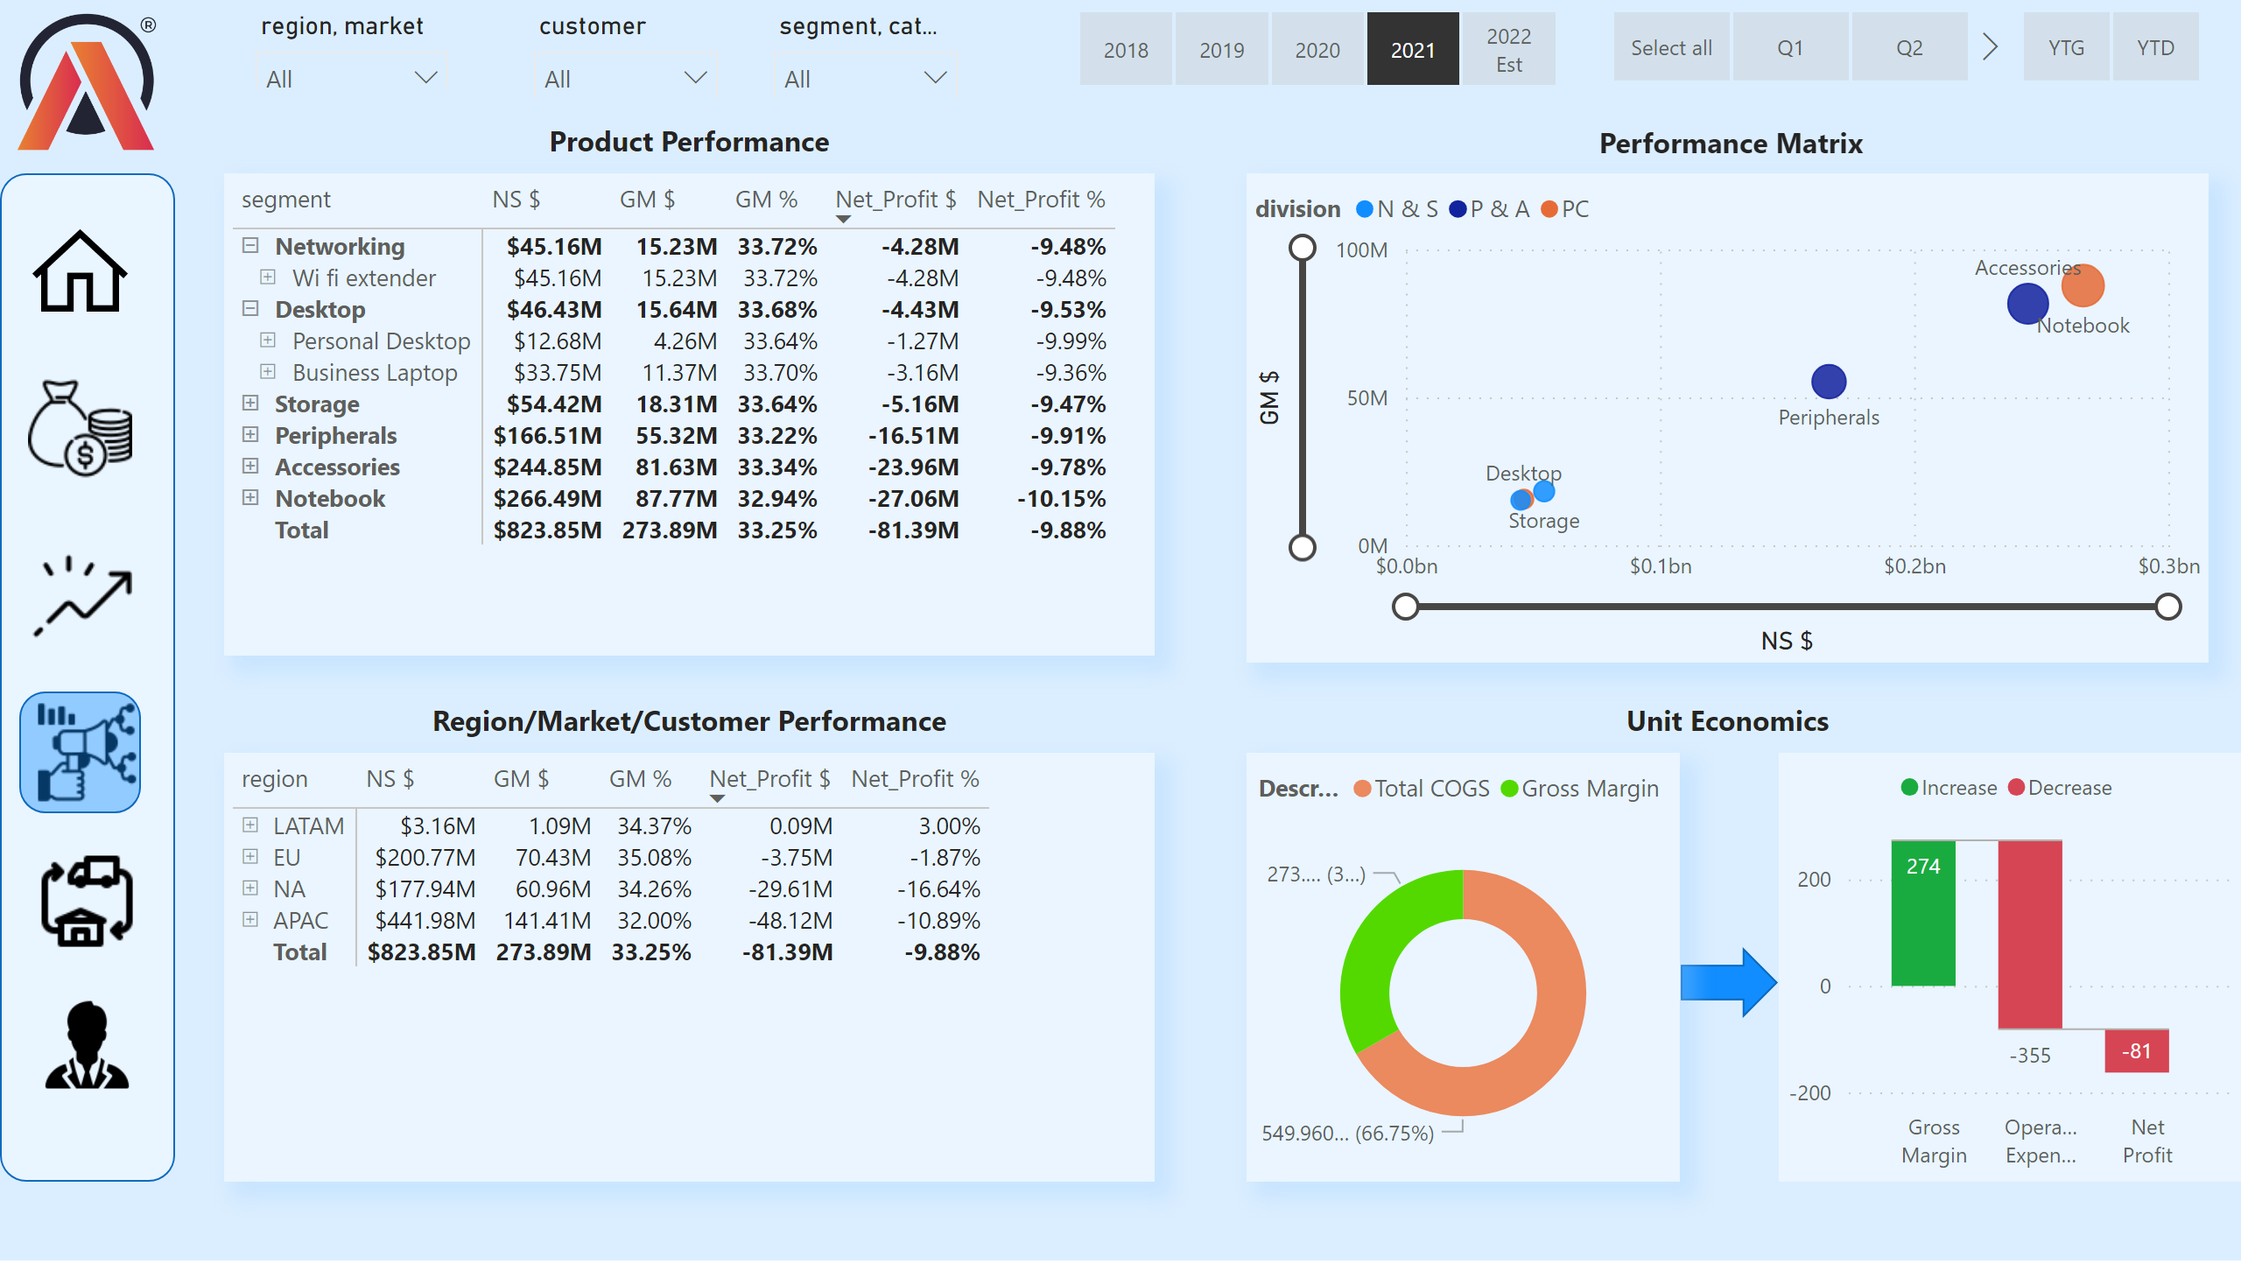
Marketing_view
Notes:
scatterChart
No alt text provided
pivotTable
No alt text provided
waterfallChart
No alt text provided
shape
No alt text provided
donutChart
No alt text provided
pivotTable
No alt text provided
image
No alt text provided
image
No alt text provided
image
No alt text provided
image
No alt text provided
image
No alt text provided
image
No alt text provided
shape
No alt text provided
image
No alt text provided
slicer
No alt text provided
slicer
No alt text provided
slicer
No alt text provided
slicer
No alt text provided
slicer
No alt text provided
slicer
No alt text provided
shape
No alt text provided
textbox
No alt text provided
textbox
No alt text provided
textbox
No alt text provided
textbox
No alt text provided

Slide 15
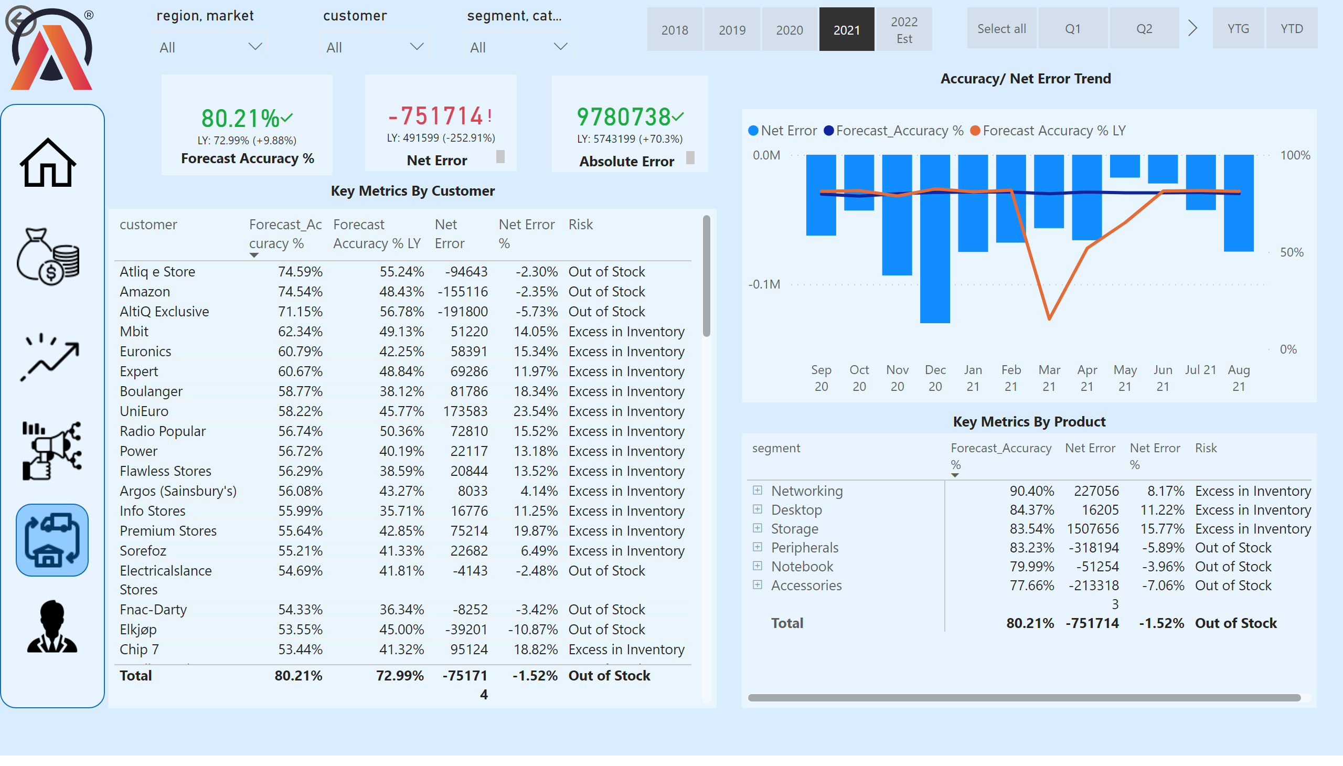
Supply chain view
Notes:
actionButton
No alt text provided
slicer
No alt text provided
slicer
No alt text provided
slicer
No alt text provided
textbox
No alt text provided
slicer
No alt text provided
slicer
No alt text provided
slicer
No alt text provided
kpi
No alt text provided
textbox
No alt text provided
kpi
No alt text provided
textbox
No alt text provided
kpi
No alt text provided
image
No alt text provided
textbox
No alt text provided
shape
No alt text provided
image
No alt text provided
image
No alt text provided
image
No alt text provided
image
No alt text provided
image
No alt text provided
image
No alt text provided
tableEx
No alt text provided
pivotTable
No alt text provided
textbox
No alt text provided
lineClusteredColumnComboChart
No alt text provided
textbox
No alt text provided
shape
No alt text provided

Slide 16
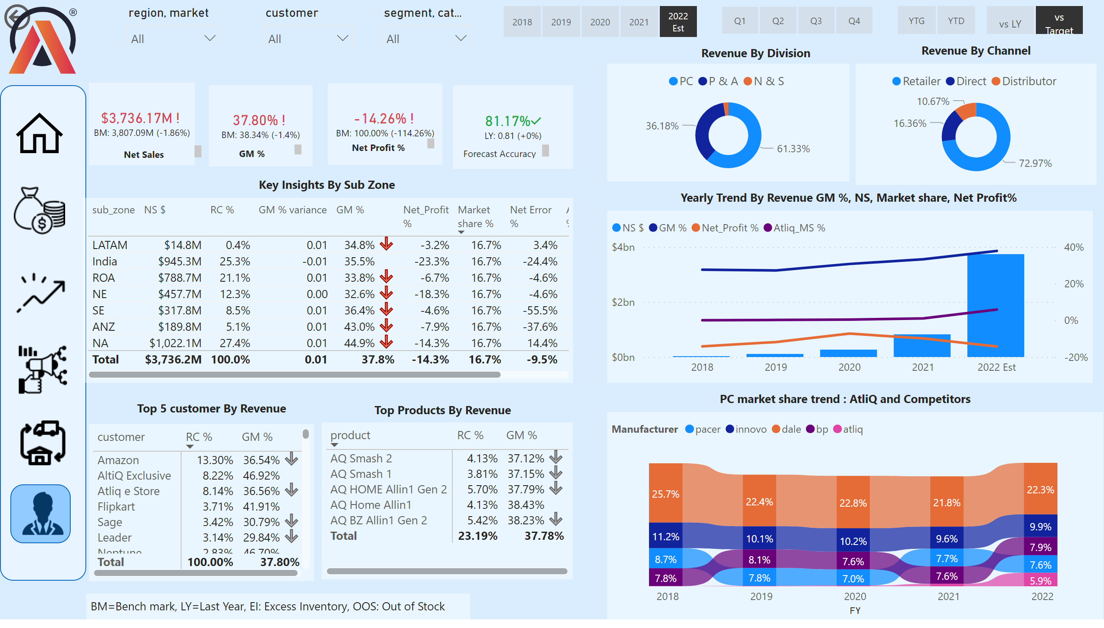
Executive view
Notes:
actionButton
No alt text provided
slicer
No alt text provided
slicer
No alt text provided
slicer
No alt text provided
textbox
No alt text provided
slicer
No alt text provided
slicer
No alt text provided
slicer
No alt text provided
kpi
No alt text provided
textbox
No alt text provided
kpi
No alt text provided
textbox
No alt text provided
kpi
No alt text provided
image
No alt text provided
textbox
No alt text provided
shape
No alt text provided
image
No alt text provided
image
No alt text provided
image
No alt text provided
image
No alt text provided
image
No alt text provided
image
No alt text provided
textbox
No alt text provided
slicer
No alt text provided
card
No alt text provided
kpi
No alt text provided
textbox
No alt text provided
donutChart
No alt text provided
donutChart
No alt text provided
textbox
No alt text provided
textbox
No alt text provided
tableEx
No alt text provided
lineClusteredColumnComboChart
No alt text provided
ribbonChart
No alt text provided
textbox
No alt text provided
textbox
No alt text provided
pivotTable
No alt text provided
textbox
No alt text provided
textbox
No alt text provided
pivotTable
No alt text provided
shape
No alt text provided

Slide 17
Live dashboard Link

Slide 18
Thank you
Kapilkumar Gohil
gohil.kapil52@gmail.com

